Slide 1
The M 5.7 Central Virginia Earthquake of August 23, 2011:
A Complex Rupture?
M. C. Chapman
Department of Geosciences
Virginia Polytechnic Institute and State University
Blacksburg, Virginia 24061
mcc @ vt.edu
Meeting of the Eastern Section, Seismological
Society of America
Little Rock, Arkansas, October 16-18, 2011

Slide 2
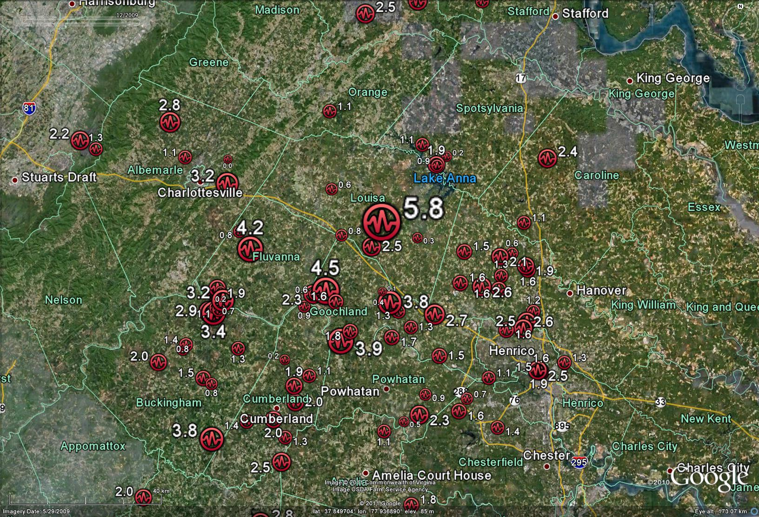
Circles show earthquake epicenters instrumentally located by the Virginia Tech
Seismological Observatory in central Virginia, 1977 - Present. Numbers are earthquake
magnitude.

Slide 3
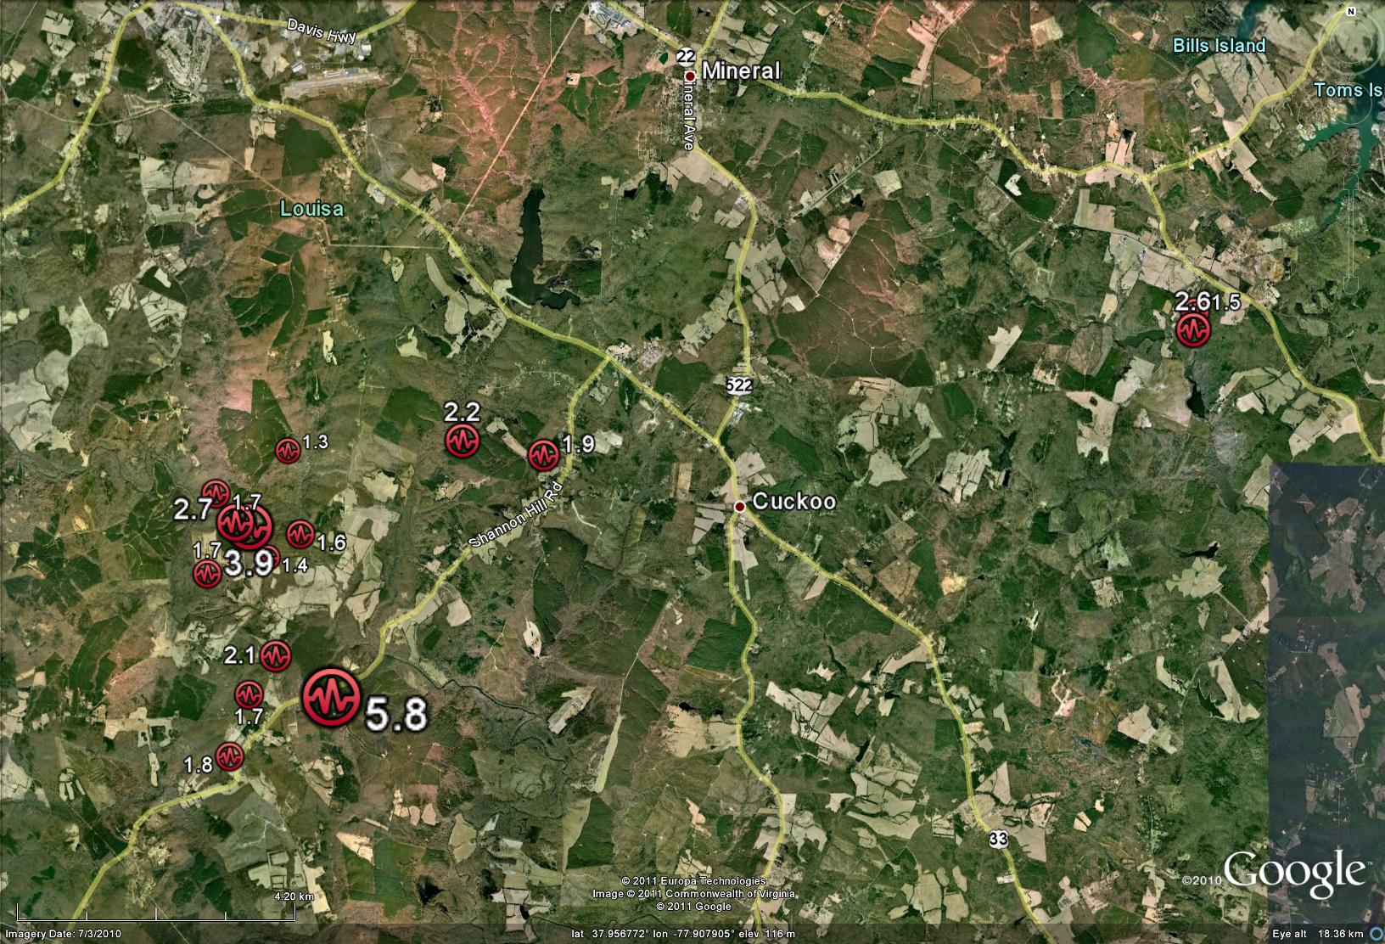
August 23, 2011, M 5.7 Louisa, Virginia Earthquake
Circles show mainshock and early (Aug. 24-26) aftershock epicenters (Virginia Tech).

Slide 4
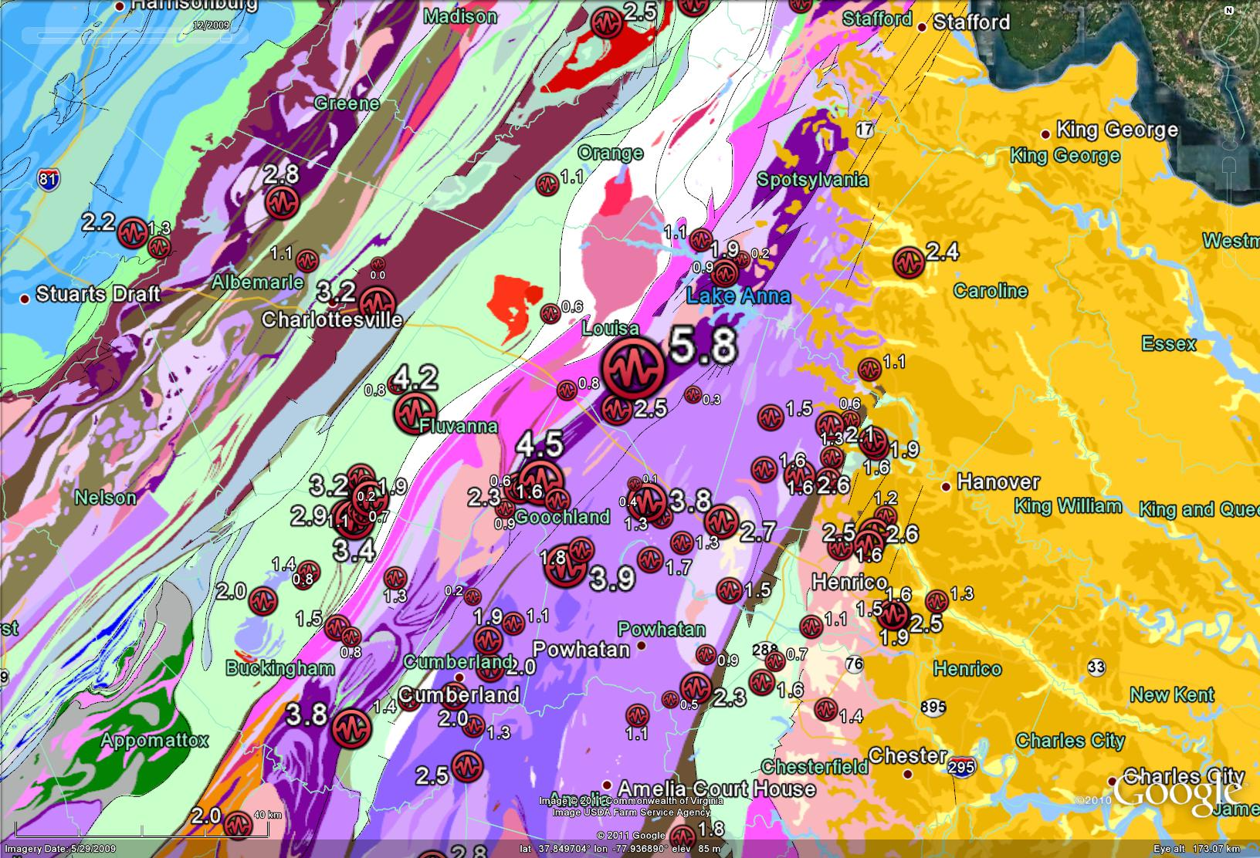
Circles show earthquake epicenters instrumentally located by the Virginia Tech
Seismological Observatory in central Virginia, 1977 - Present. Numbers are earthquake
magnitude. Colored regions indicate major geologic units.

Slide 5
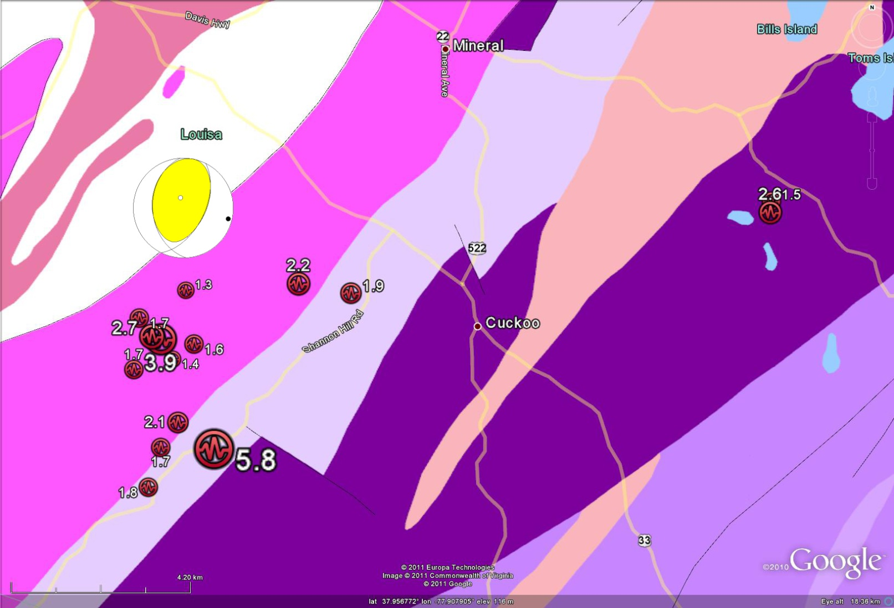
Circles show mainshock and early (August 24-26) aftershock epicenters (Virginia Tech).
Beachball diagram indicates the mainshock focal mechanism (USGS/SLU). Colored areas
show major geologic units.

Slide 6


Slide 7
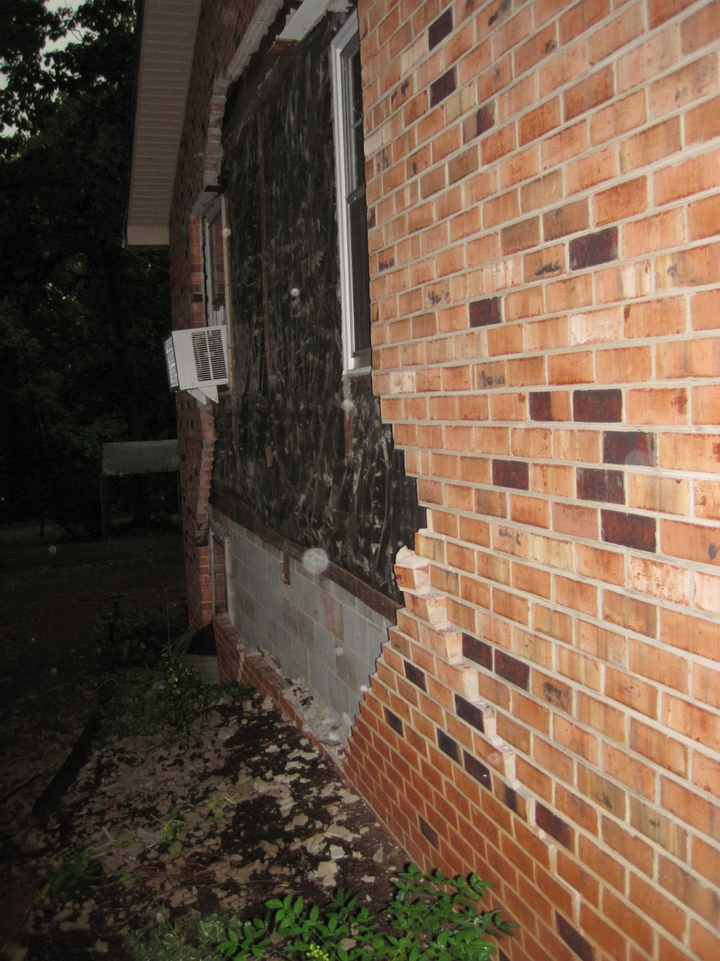
11, 000 reports of damage in
Louisa County, Virginia were
received within two weeks of
the earthquake. Louisa County
High School was damaged and
remains closed.
"If damage from a once-in-a-generation,
5.8 magnitude earthquake does not
qualify for federal disaster relief,
then I don't know what does. I am
very disappointed that FEMA has
determined that Louisa County does not
qualify for federal disaster assistance
for individuals, and I fully support the
Governor's decision to appeal."
Senator Mark Warner, October 7, 2011.

Slide 8
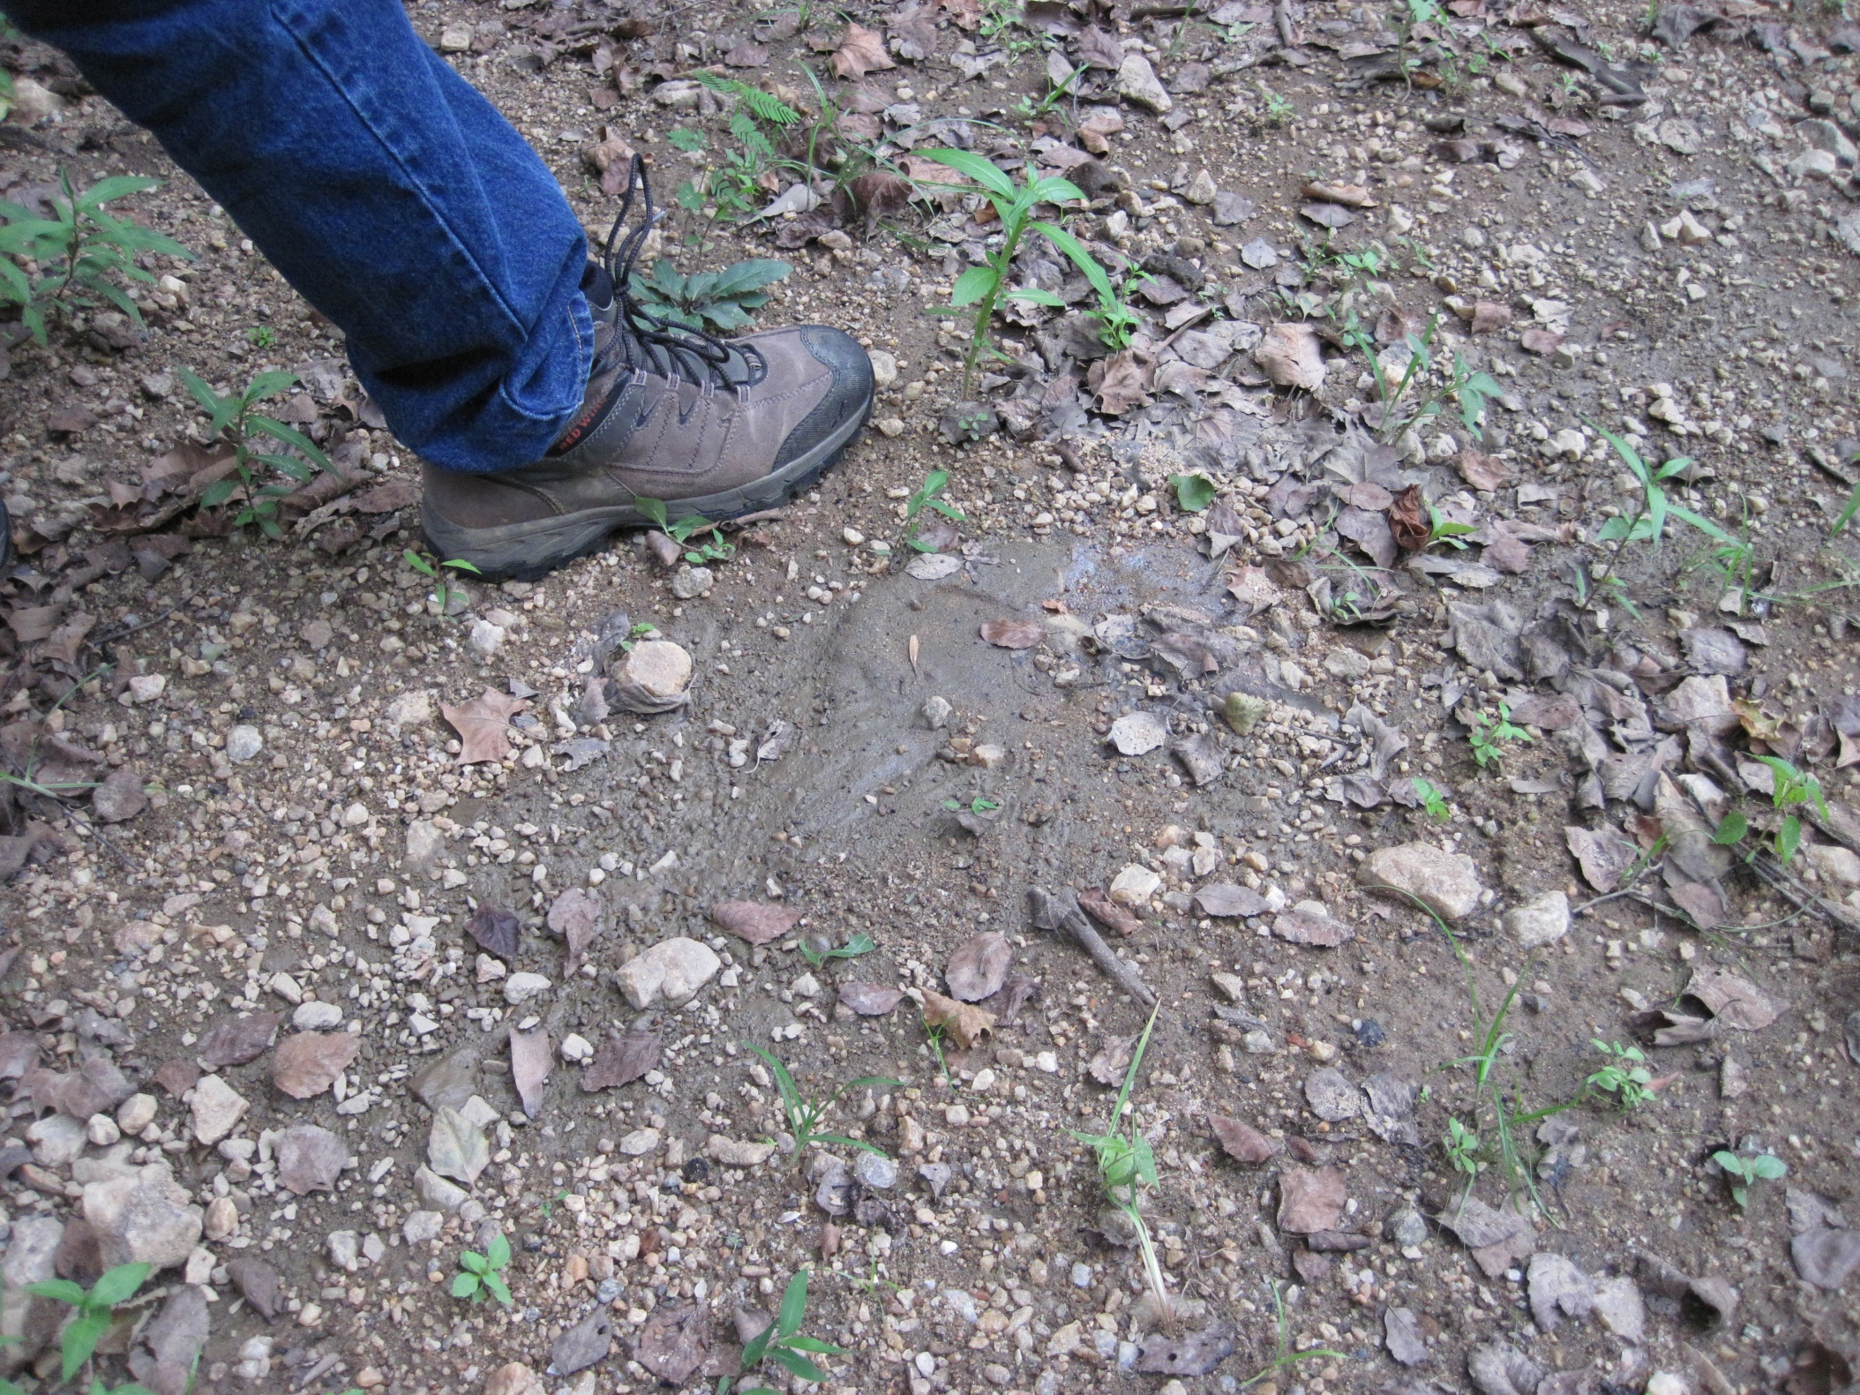
Jeff Munsey's right foot
Liquefaction feature he
discovered at Yancey Mill, near the intersection of Vigor and Yanceyville roads

Slide 9
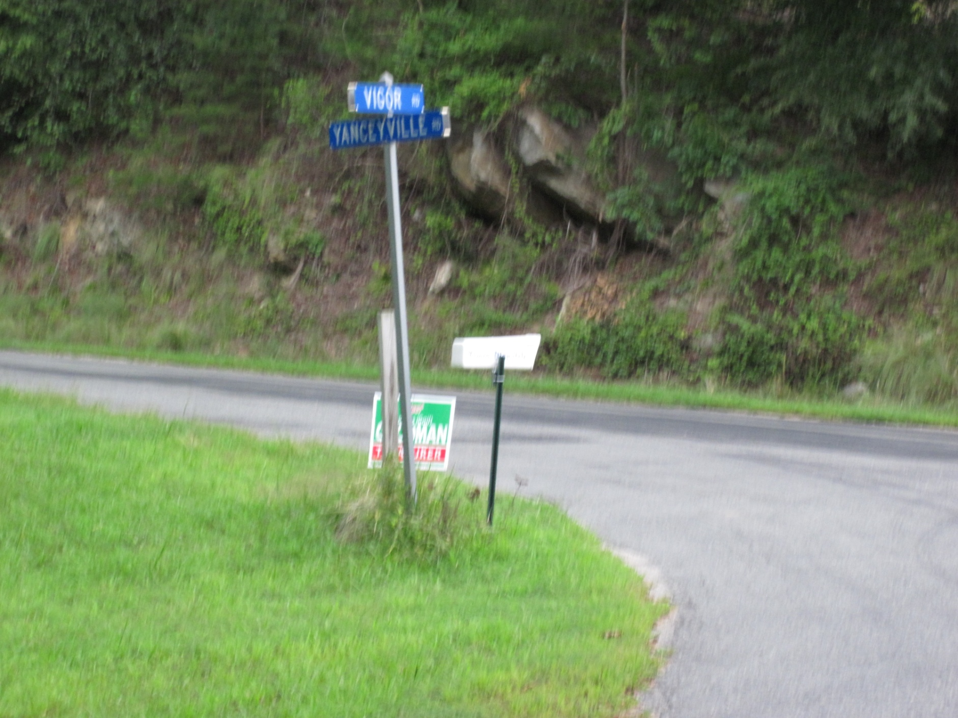
The Epicenter

Slide 10
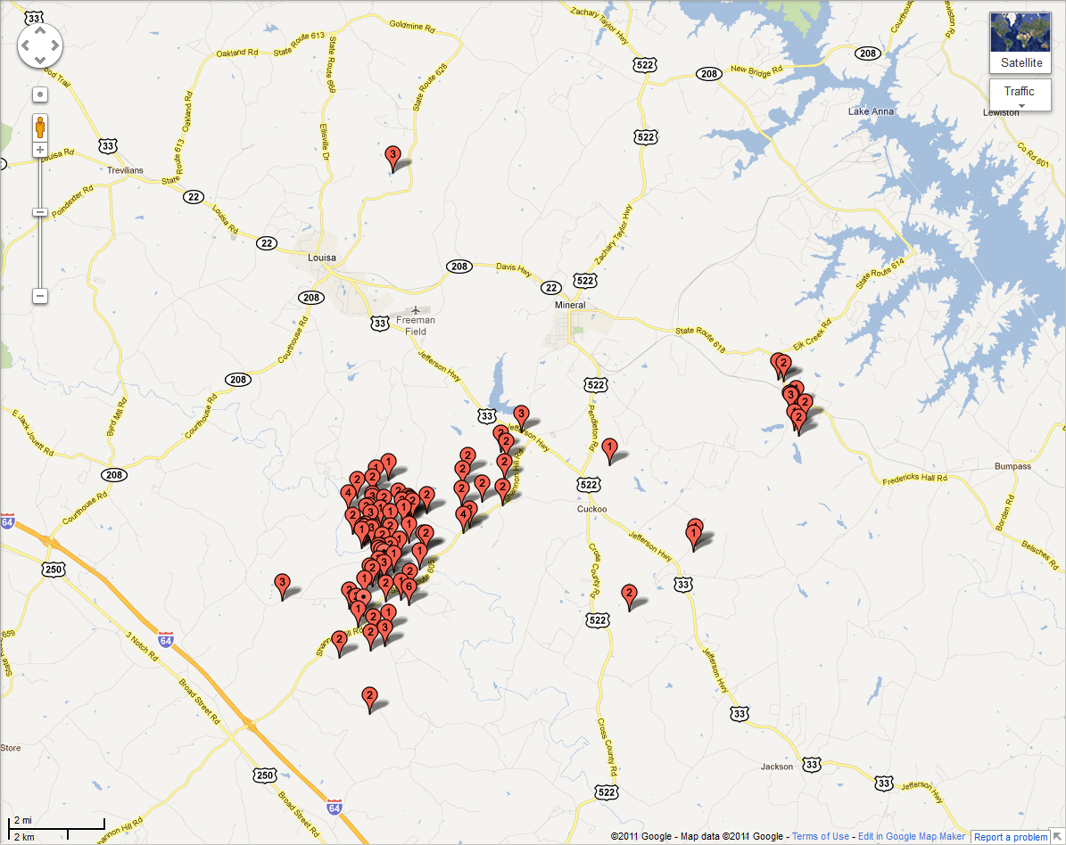

Slide 11
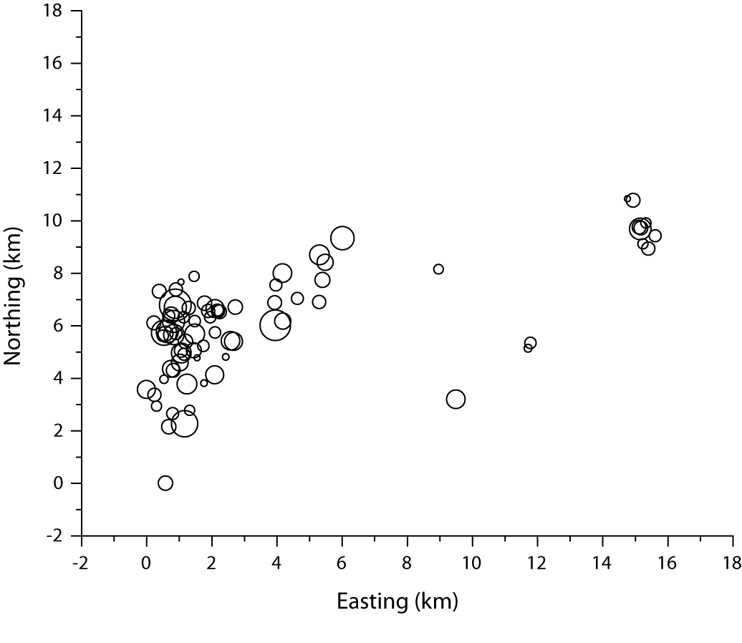
Two clusters of aftershocks?

Slide 12
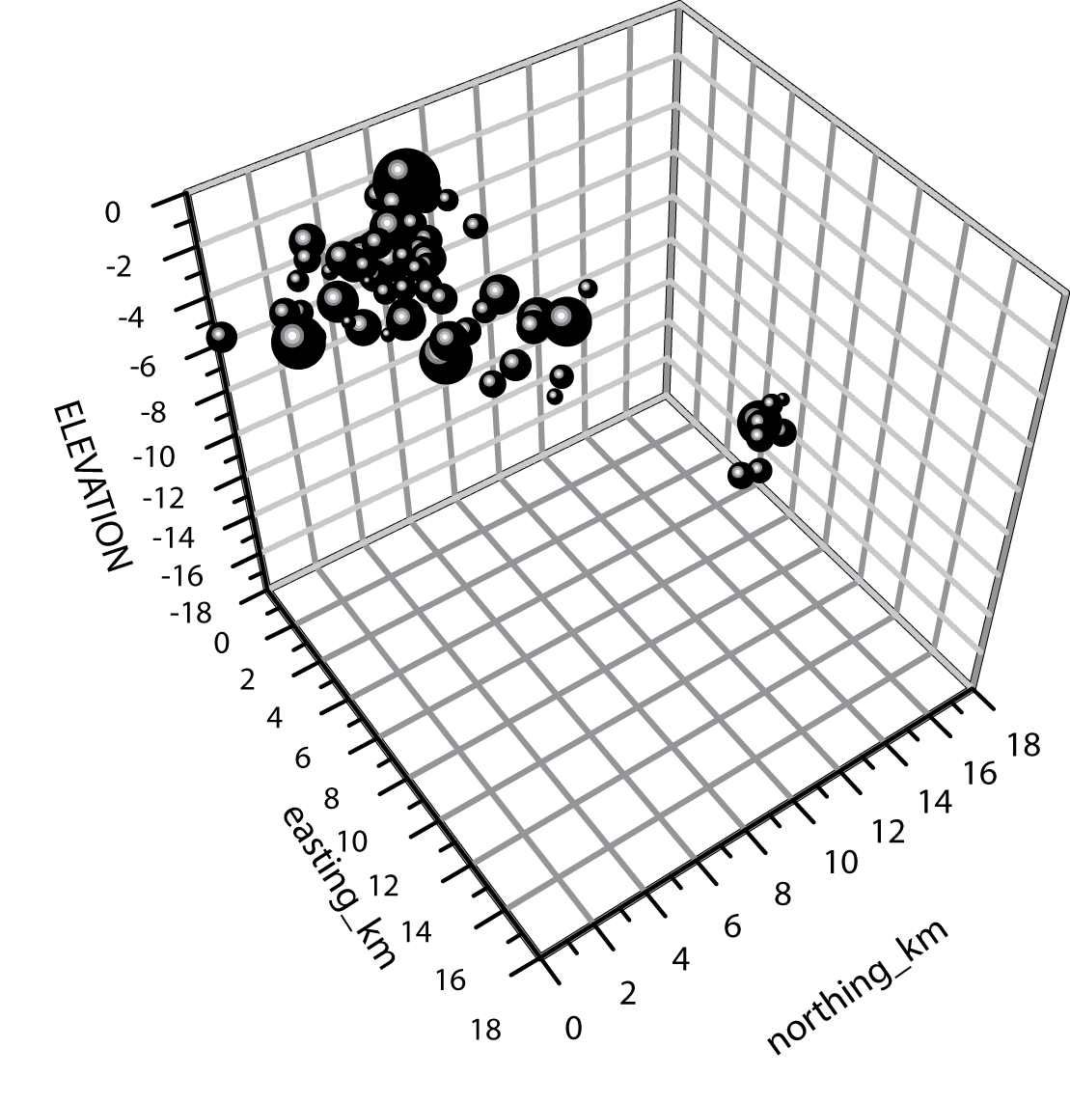
Looking broadside at the
fault plane

Slide 13
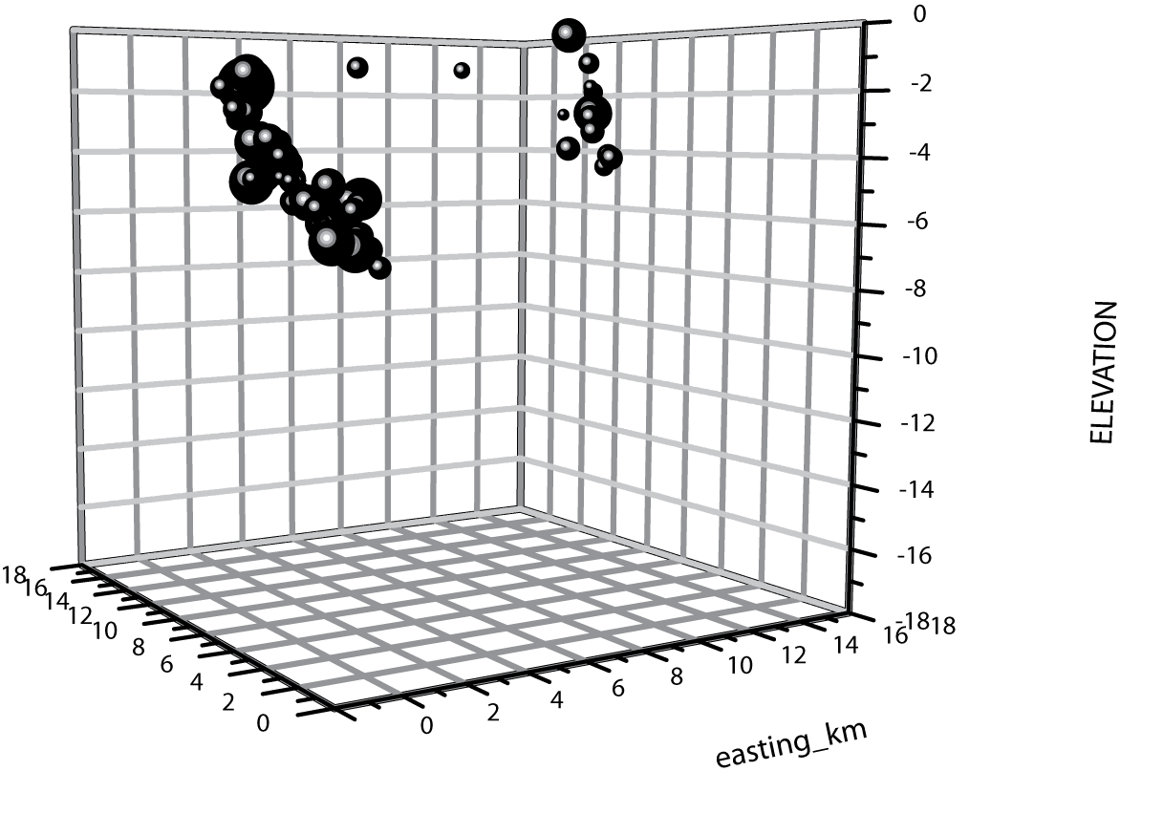
Looking approximately N25E

Slide 14
North Anna
Power Station
21 km

Slide 15
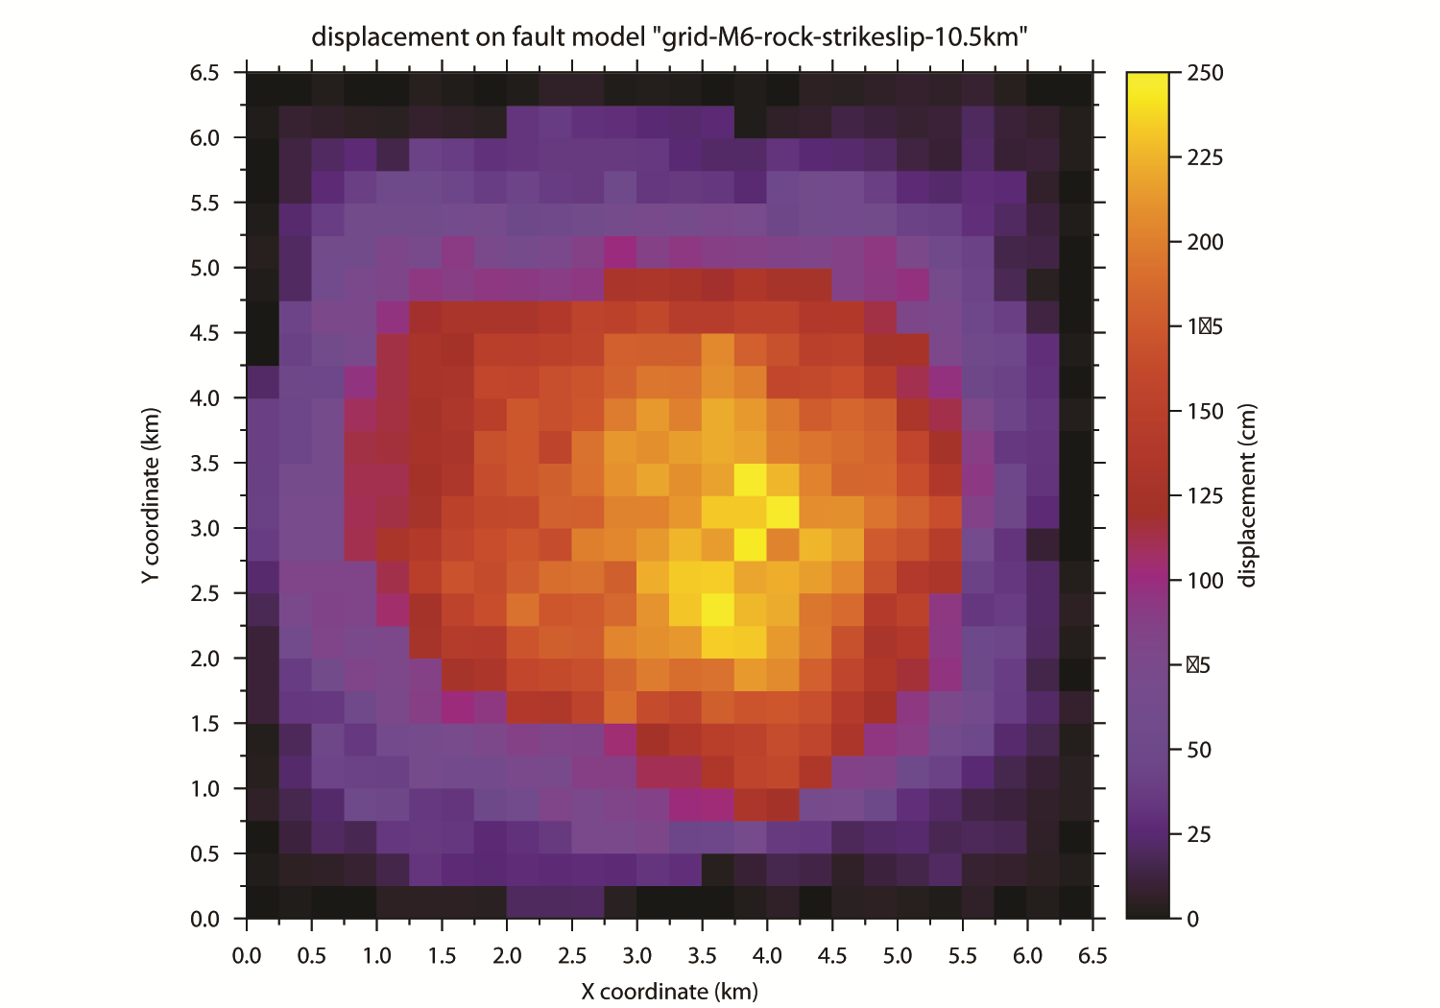
Simulated slip distribution for a M 6.0 earthquake
6.5 X 6.5 km rupture area, static stress drop 100 bars
Mean slip is 84 cm
The finite-fault source is a composite
of circular, overlapping faults, randomly
distributed on the fault plane, following
the method described by Zeng et al.,
(1994)
The Green function for each subfault-receiver is calculated using "hspec96", written by Dr. Robert Herrmann (2002), using the wavenumber integration approach to produce a full wavefield simulation.
Zeng, Y., J.G. Anderson and G. Yu (1994). A composite source model for computing realistic synthetic strong ground motions, Geophysical
Research Letters, 21, 725-728.
Herrmann, R.B. (2002). An Overview to Synthetic Seismogram Computation, in software distribution Computer Programs for Seismology,
St. Louis University, St. Louis, Missouri, http://www.eas.slu.edu/People/RBHerrmann/CPS330.html

Slide 16
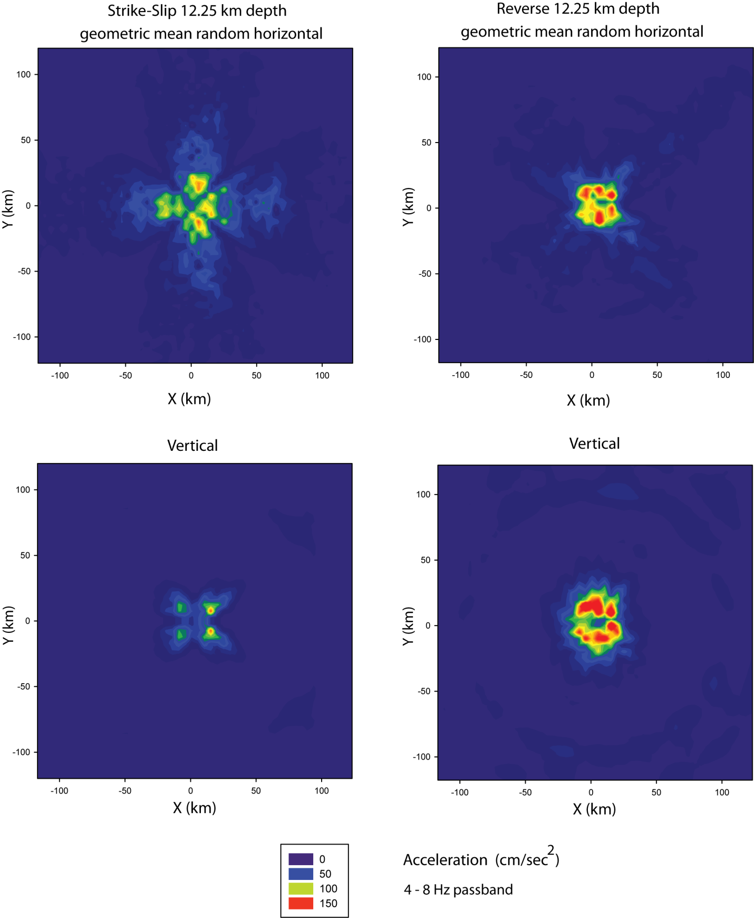
Simulated maximum acceleration amplitudes in the 4-8 Hz band
M = 6.0 finite fault simulation
12 km focal depth, rock-1 velocity model
geometric mean
random horizontal
component
strike-slip
mechanism
geometric mean
random horizontal
component
reverse mechanism
(45 degree dip)
vertical component
strike-slip mechanism
vertical component
reverse mechanism
(45 degree dip)

Slide 17
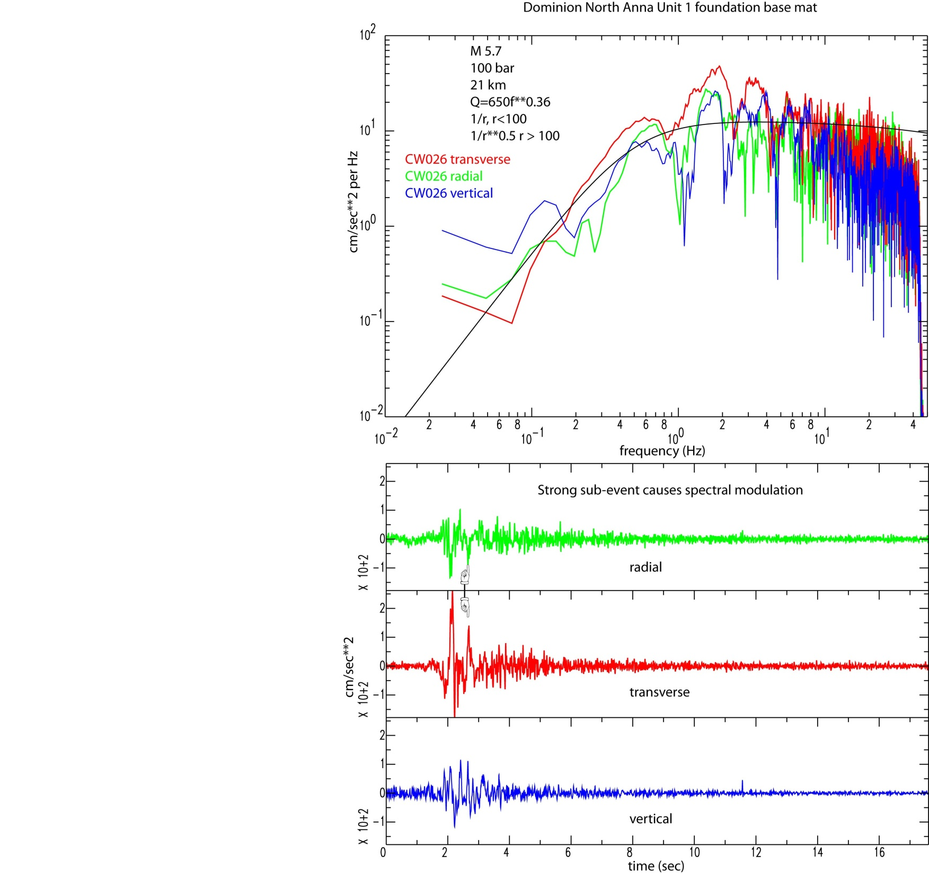
Strong motion recordings
on the foundation base mat
of the unit 1 containment structure
at North Anna.
The records are remarkable for the
very short duration, and pulse-like
character of the largest motion---
the S wave(s).
Note the modulated character of
the Fourier amplitude spectra

Slide 18
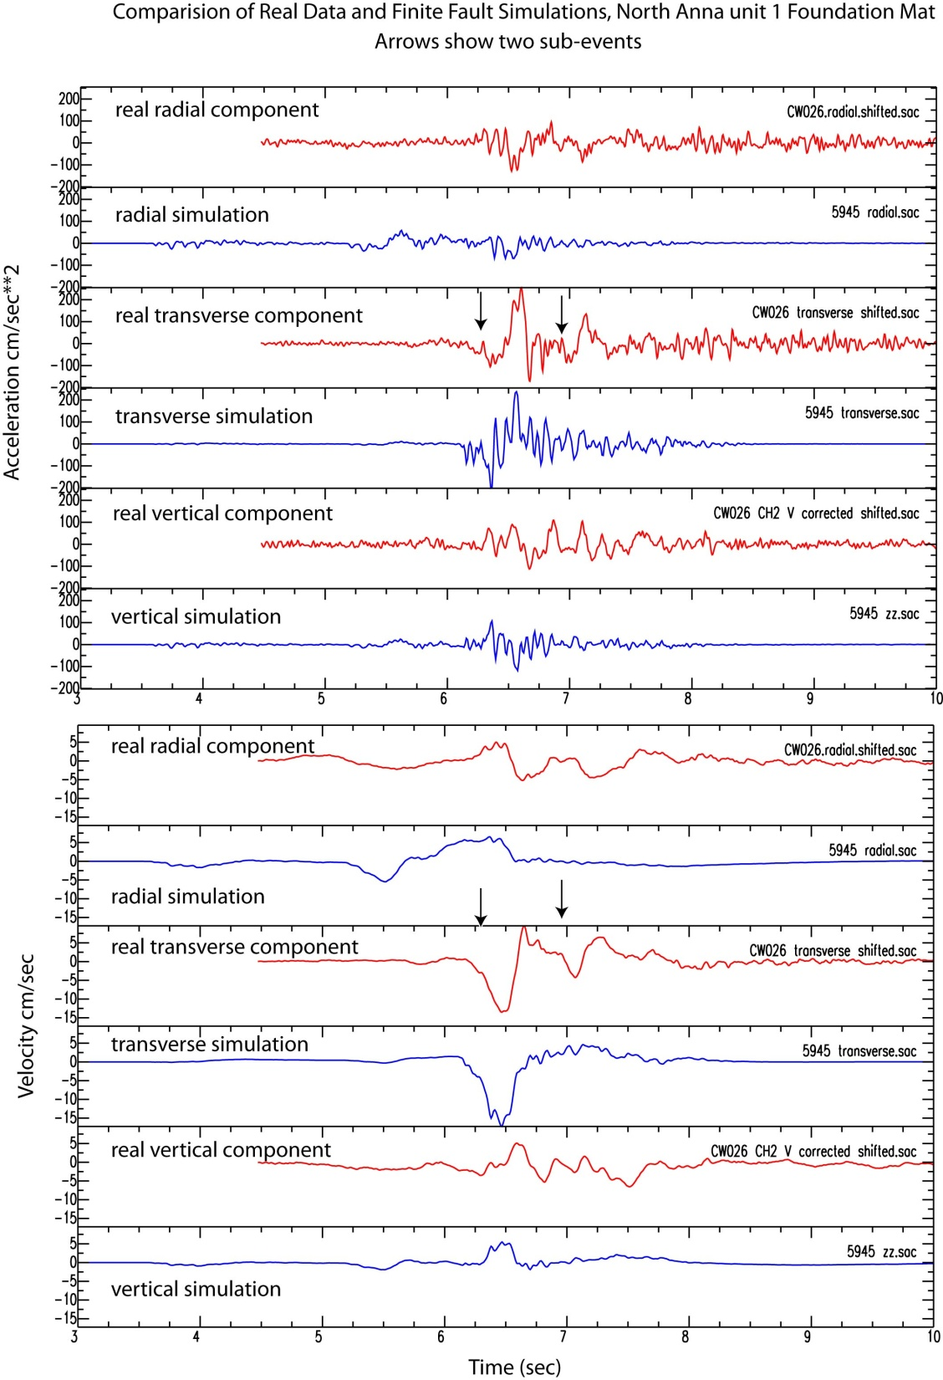
The simulations are for a
M 6.0 event at a hypocenter
depth of 7.5 km, pure reverse
mechanism, dip 45 degrees.
The simulated source-receiver
geometry is very similar to the
actual earthquake - North Anna
situation.
Arrows point to a possible secondary
arrival pulse in the
real data that is absent in the
simulations.

Slide 19
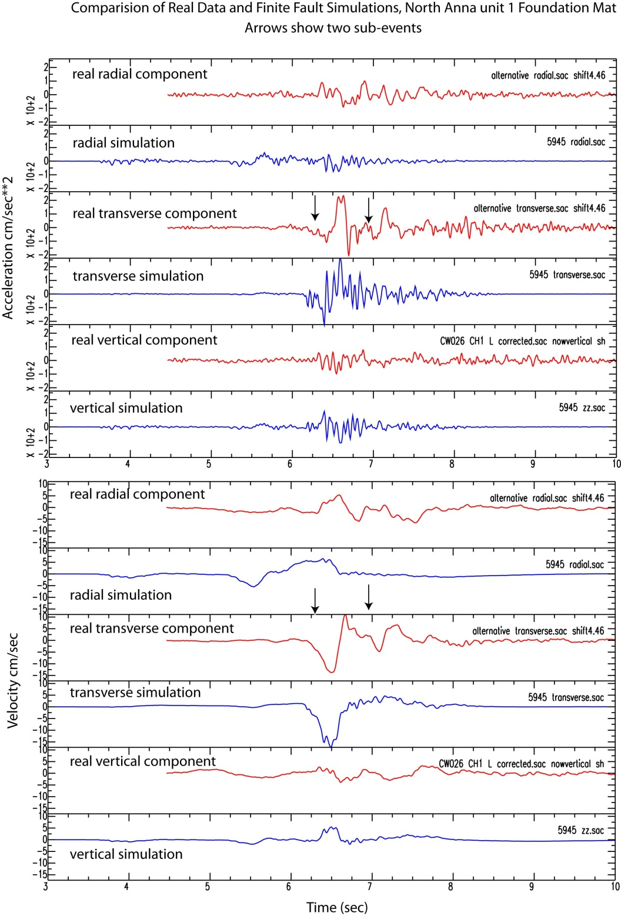
It seems like this stuff is
never straightforward.
In this case, there is some confusion
over which channel is which.
In terms of the subevent, it does not
matter if Ch1 and CH2 are
swapped: it is still there.

Slide 20
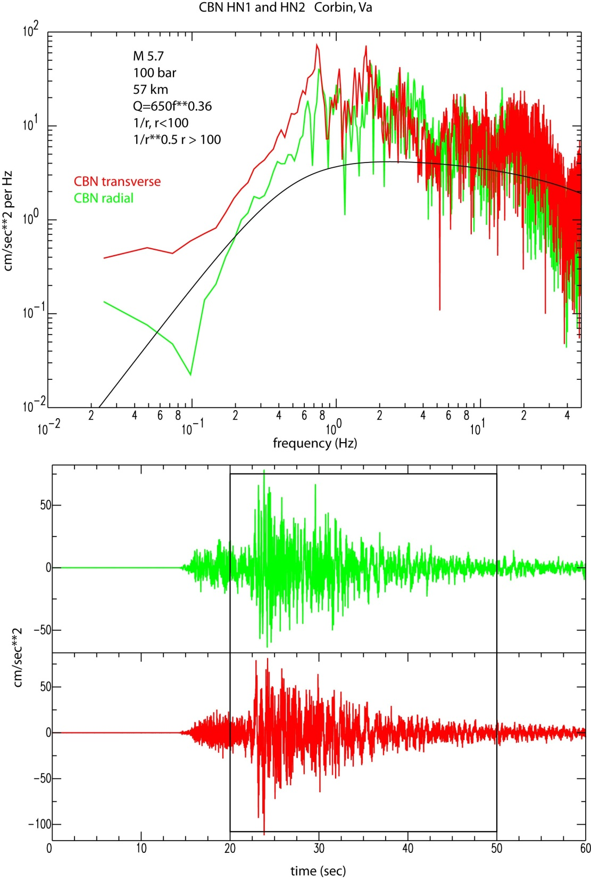
Data recorded at CBN (61 km)
also feature strong spectral
modulations. However, the
CBN station is know to have a
very strong site response.

Slide 21
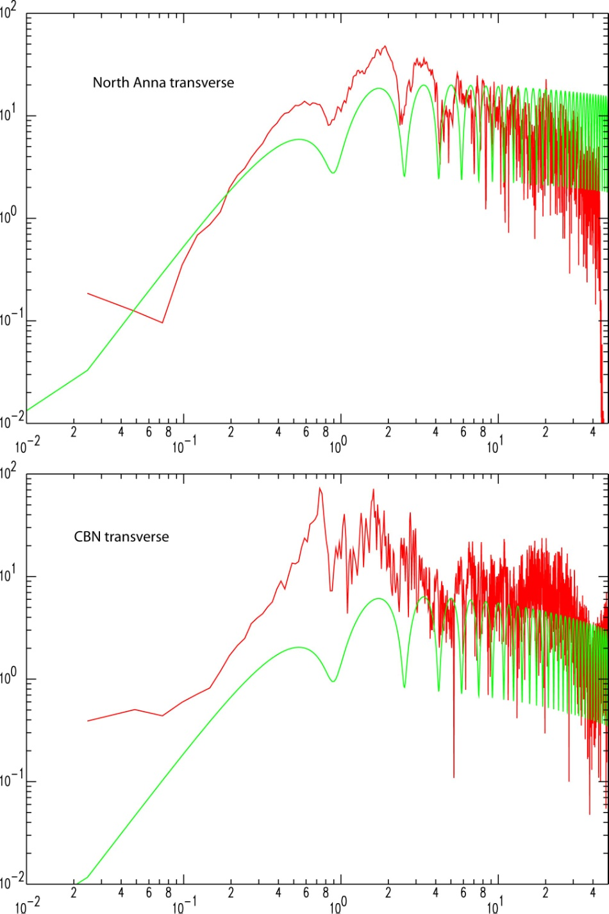
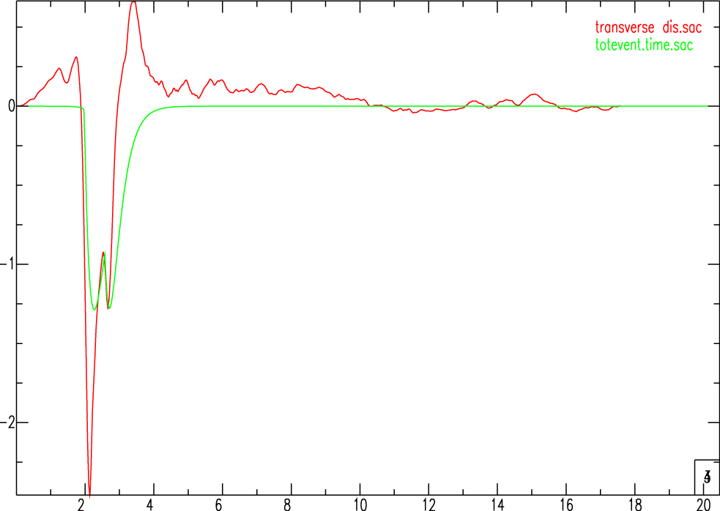
Comparison of North Anna
with CBN.
The Green lines
shows the Fourier Amplitude
spectrum for a source comprised
of two Brune pulses with moment
3 x 10**24 and 1 x 10**24 dyne-cm
separated by 0.6 seconds.
cm/sec**2 per Hz
Recorded transverse displacement at North Anna
cm/sec**2 per Hz
cm
two Brune pulses superimposed
Frequency (Hz)
time (sec)

Slide 22
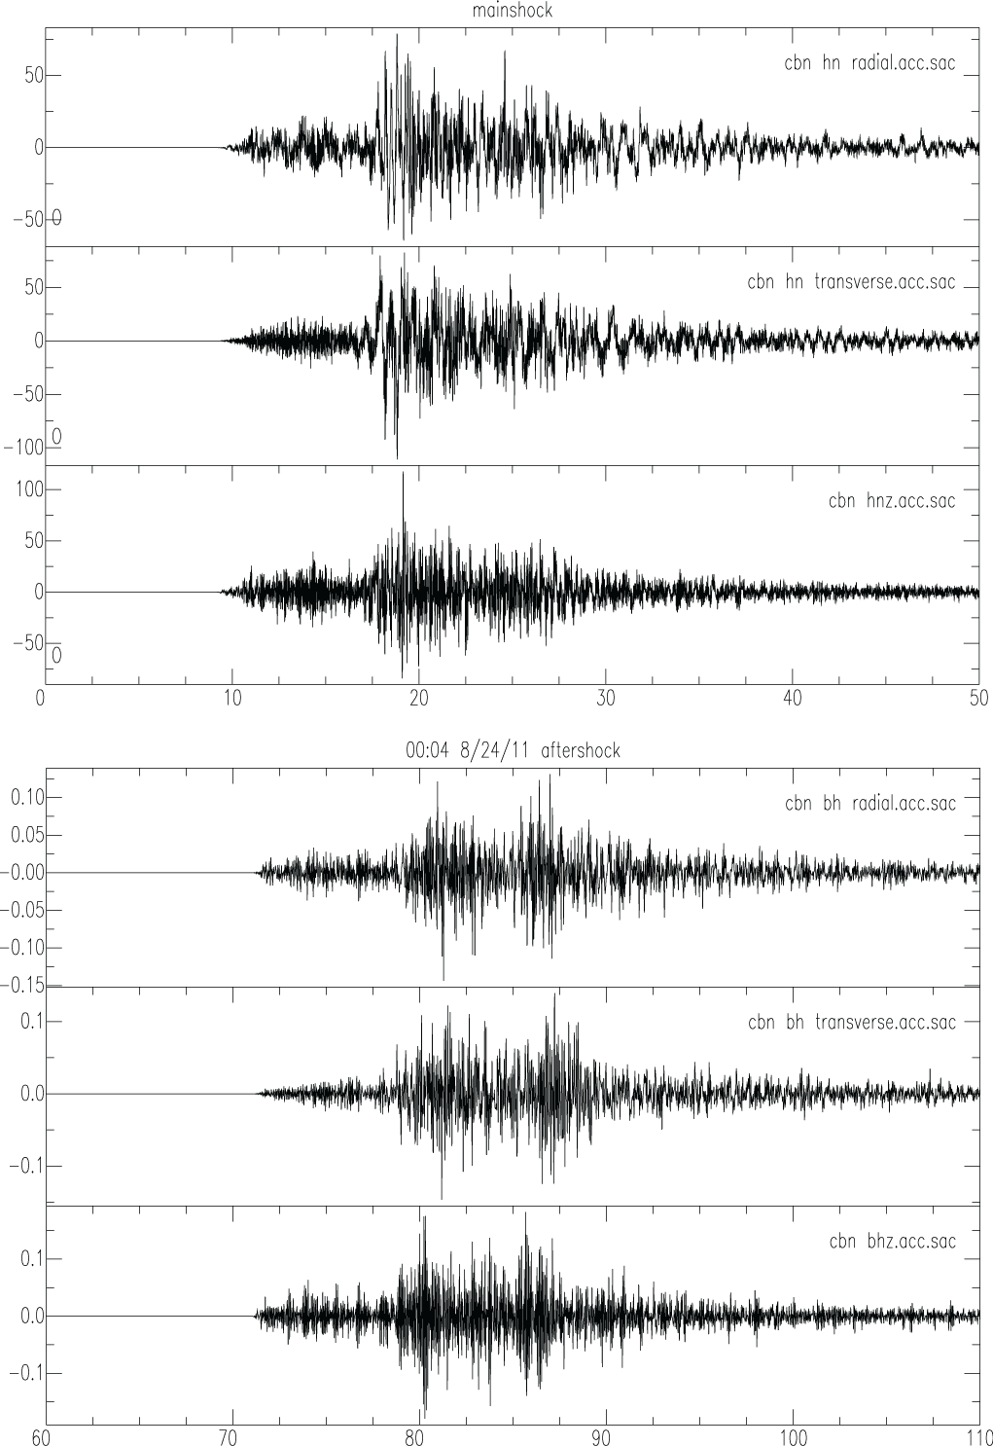
It is possible that wave propagation
effects are responsible for the
the secondary pulse at North Anna,
and resulting spectral modulation.
Assuming that the mainshock and
and an aftershock are located close
together, any spectral modulation
due to path effects should cancel
in the spectral ratio.

Slide 23
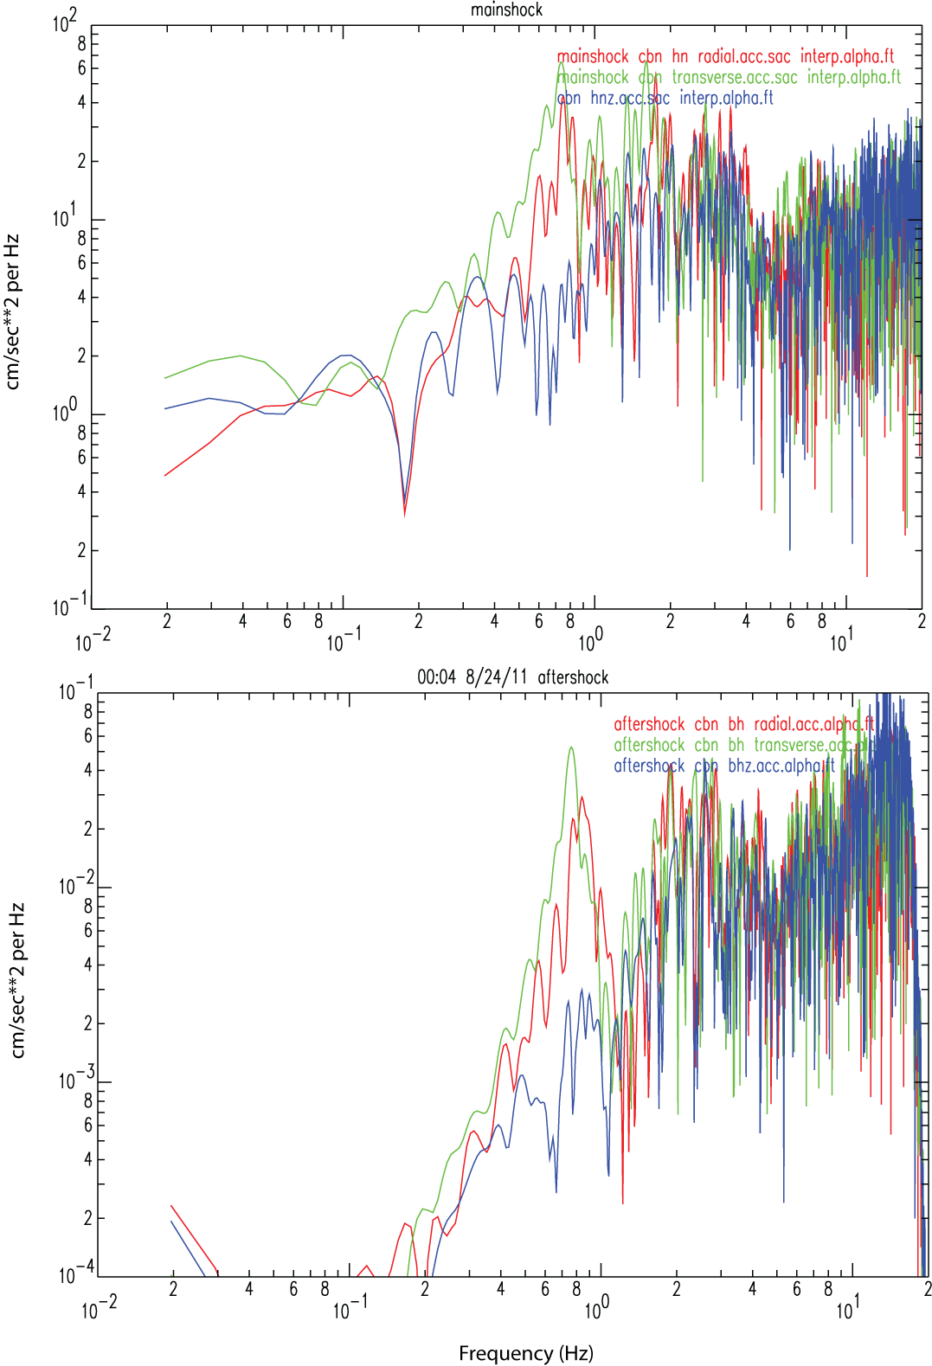
Time (sec)

Slide 24
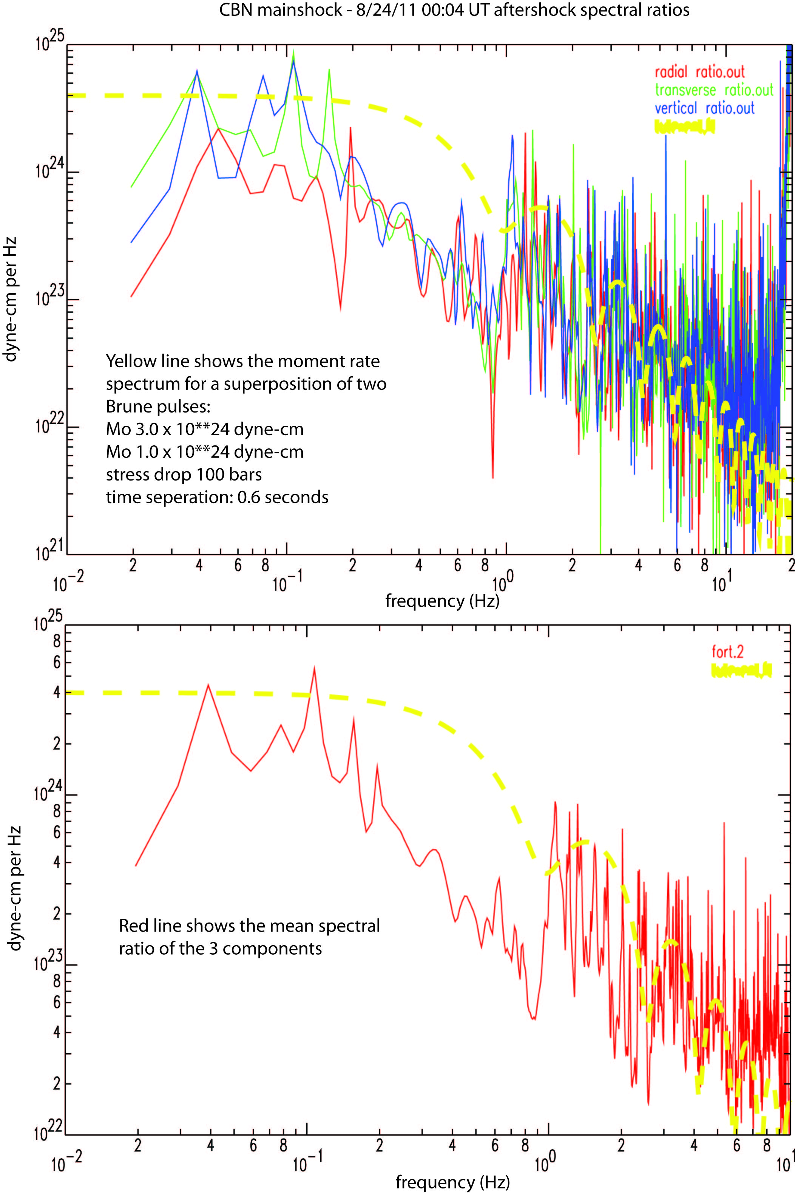
Result of forming the spectral
ratio of the CBN recording of the
mainshock and the aftershock
that occurred at 00:04 UT on
August 24, 2011.
Modulated?

Slide 25
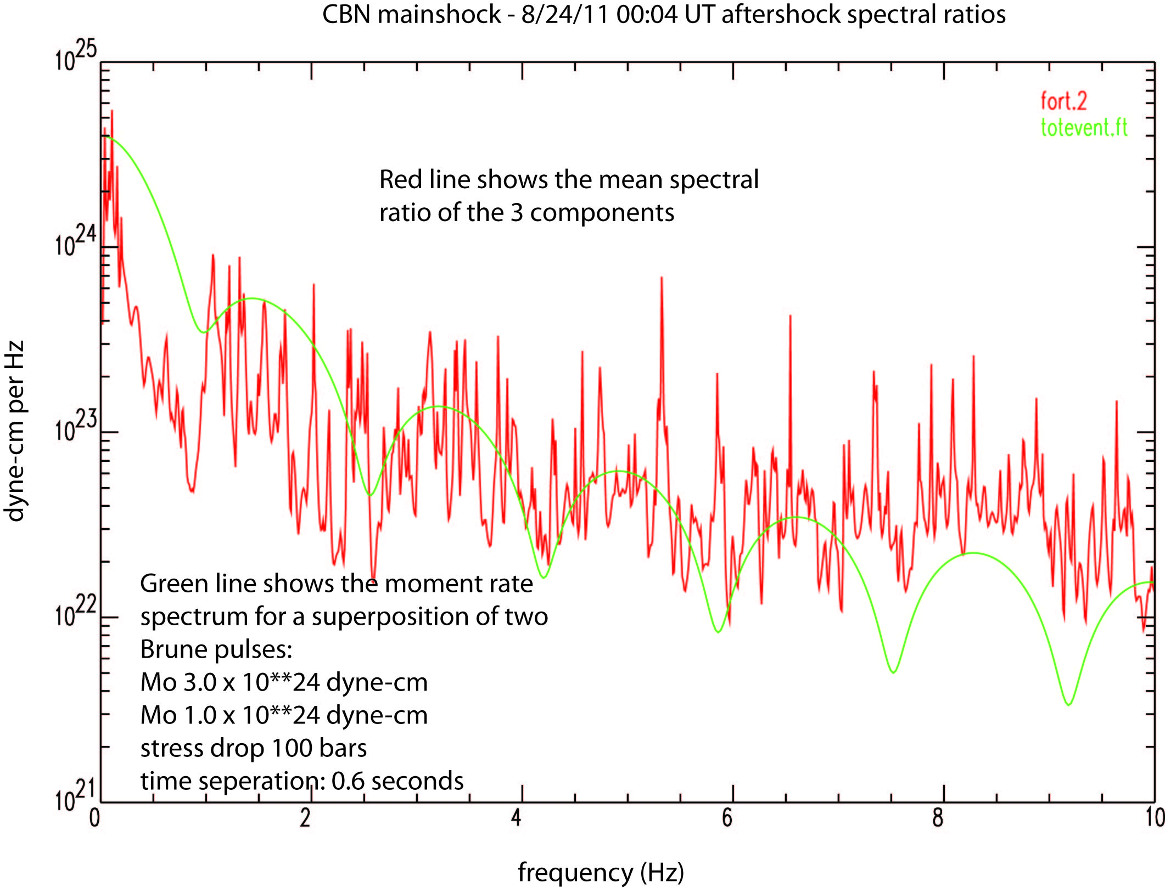

Slide 26
CONCLUSIONS
1. This was a BIG earthquake.
2. Only minor injuries occurred, but there was a lot of expensive damage in the
epicentral area, where most people are un-insured for earthquakes. FEMA has
yet to step up to the plate.
3. The best (almost only) good strong motion data inside 100 km were obtained at
the Dominion North Anna nuclear power plant. The recordings suggest that
the rupture was complex, involving a sub-event approximately 0.6 seconds after
the main slip event, with approximately 1/4 - 1/3 of the total moment release.
4. Mainshock - aftershock spectral ratios at CBN seem to support this interpretation.

Slide 27
Thank you for your attention.

